Slide 1

MeteoCal
Project development for the 2014 Software Engineering 2 Course
Authors:
Andrea Bignoli
Leonardo Cella
Department of
Computer Science And Engineering
Supervisor:
Prof. Elisabetta Di Nitto

Slide 2
Preliminary Notes
In our presentation we will reference other documents produced during the development of the project. Everything that we are going to reference, including the source code, can be found at:
https://code.google.com/p/meteocal-bignoli-cella/

Slide 3
Requirement analysis and specification

Slide 4
Problem Description
The first step in the development of this project was an accurate and precise analysis of the initial requirements. This allowed us not only to formalize the initial description of the problem, but also to solve any ambiguity due to the natural language formulation.
“The X company wants to offer a new weather based online calendar for helping people scheduling their personal events avoiding bad weather conditions in case of outdoor activities. Users, once registered, should be able to create, delete and update events. An event should contain information about when and where the event will take place, whether the event will be indoor or outdoor. During event creation, any number of registered users can be invited. Only the organizer will be able to update or delete the event. Invited users can only accept or decline the invitation. Whenever an event is saved, the system should enrich the event with weather forecast information (if available). Moreover, it should notify all event participants one day before the event in case of bad weather conditions for outdoor events. Notifications are received by the users when they log into the system.”

Slide 5
Ambiguity Resolution
In our initial analysis we decided to solve any ambiguity by providing the most complete and flexible functionality we considered useful in a real world environment.
For instance we decided to allow the creation of events of any duration, without fixing an upper bond in this phase of the project, since we considered this an unnecessary limit for the usage of our application. Our service will provide a series of weather forecasts covering the whole duration of each event. Obviously the weather forecasts checks regarding adverse conditions will consider the whole duration of the event.
We also assumed that events of a user may overlap, since this was the possibility that granted more flexibility of operation to end user.

Slide 6
Ambiguity Resolution
An other important decision that we made is that the creator of an event should be allowed to choose, for each event which weather conditions should be considered adverse.
Even if this is not mentioned in the initial problem description, we considered this functionality as really important in a real world application.
The system will then produce notifications about weather forecasts depending on the set of adverse weather conditions defined by the creator of the event.

Slide 7
Functional Requirements
With the previous considerations we formulated the following functionalities to provide, devided by actor involved:
Guest
Sign up
User
Login
Account Management (view settings, edid settings, calendar privacy...)
Calendar Management (view, reach event, manage...)
Event Creation
Event Management (view, participate, cancel participation...)
Invitation Management (view, reach related event, reply...)
Notification Management (view, reach related event...)
Search for events and users on the system
View event and user pages according to visibility rules

Slide 8
Functional Requirements
Event creator (on the created event)
Invite users
Edit event details, scheduling
Cancel event
Receive a suggested reschedule change in case of bad weather conditions
The system will provide and update weather forecasts for all the planned events whenever available and automatically notify the creator in case a better scheduling for an event is found. The notifications are generated according to the problem description.
The description presented here provides a basic overview of the functionalities our system offers. More details can be found in the Requirement Analysis and Specification Document.

Slide 9
Non – Functional Requirements
User visible aspects of the system, not directly related to the functional behaviour.
User Interface: a practical and intuitive website;
Client:
Errors Handling: all the errors observed in the testing phase were conveniently managed;
Documentation: RASD, DD, User Guide, Installation Guide.
To use our application is not required any specific knowledge, and is neither necessary an installation;

Slide 10
Non – Functional Requirements
Brief but complete description of the mode of operation, purely descriptive.
It starts with the registration of a new account;
Through the login with a registered account, we are redirected to the page that contains our own calendar;
In the upper part of the page there is an instruments bar, this groups the main offered functionalities and some alert messages;
In closing, the calendar shows the events related to the connected user. To see them deeper, one has just to click on the desired event and a new page with all the details will be opened.

Slide 11
Architectural Considerations
The website is realized with the J2EE technology, it is sustained on a MySql database for the information management.
From the graphic point of view, we have used the components offered by the PrimeFaces library, these modules are then arranged with style sheets in order to get a more accurate arrangement.
In closing in the matter of the weather forecasts service, we rely upon an OpenWeatherMap.
The user who is interested in using our service, needs only an internet connection and an up-to-date browser.

Slide 12
Model Coherency – Alloy Analysis
We made use of Alloy to verify the coherency of the model we formulated to answer the requirements we stated. The analysis is the most accurate possible in the representation of our system.
In particular, all the main relationship regarding users, events, notifications, invitations and weather forecasts have been considered and included in the model.

Slide 13
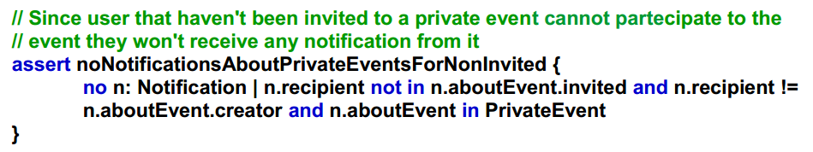
Model Coherency – Alloy Analysis
We were able to check different aspects regarding the coherency of the service offered. For example, the following code ensures that no notification regarding a private event can be sent to users that haven’t been invited to the event.

Slide 14
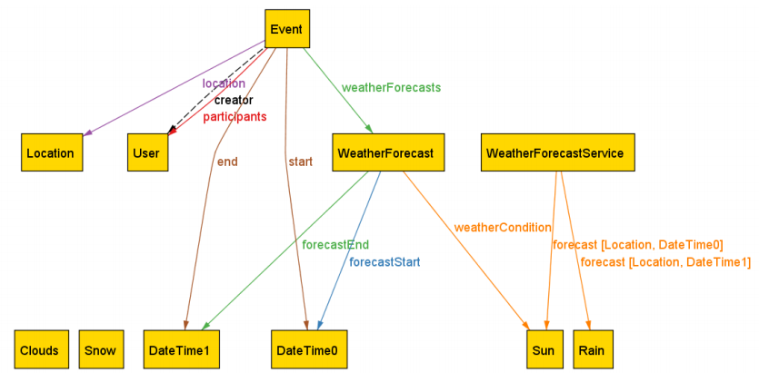
Model Representation – Alloy Analysis
The alloy analysis also allowed us to produce diagrams showing different relationship between the elements of our application.
The forecast sequence associated to an event covers its duration.
The forecasts provided are the ones produced by the external weather forecast service for the given location and time (associated to weather conditions not represented here for clarity).

Slide 15
Use Case Analysis
A detailed version of the use cases is reachable in the RASD, here we want to take just a glance focusing on the main aspects.
We start by showing an overview diagram. Later in the consecutive pages, some use cases that we considered fit to be analyzed here.

Slide 16
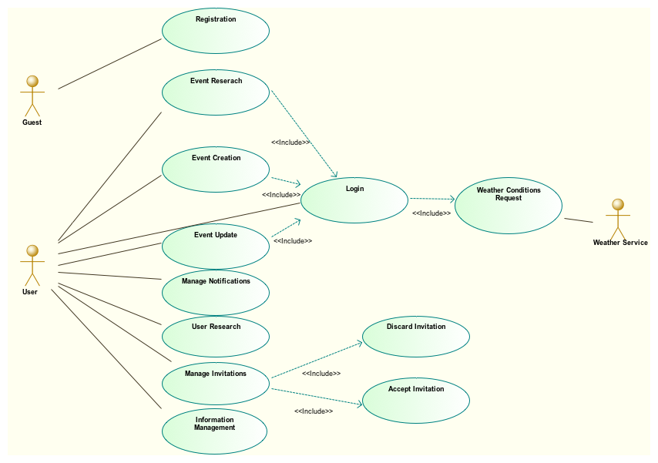
Use Case Analysis – Overview Diagram

Slide 17
Use Case Analysis – Registration
Actor: Guest;
Input conditions: a Guest chooses to sign up;
Output conditions: The Guest is granted access to a User account;
Events flow:
The Guest is brought to a page that contains the registration form;
Filling in the form’s fields with an username and a password;
The system tries to update its database with these new data;
If so Guest can login the system with his own account. Otherwise in case of any error has arised, he has to repeat this procedure.

Slide 18
Use Case Analysis – Event Creation
Actor: User;
Input conditions: The User is already logged in the system;
Output conditions: His calendar contains the just created event;
Events flow:
The User starts to create a new event thanks to the topbar;
The system provides a new form, and the User has to fill the fields with the information about the new event;
Once the User confirms the operation, the system does the required checks and operations for the event;
If so the User is brought to the created event page, otherwise if occurs any error the User can repeat this operation.

Slide 19
Design

Slide 20
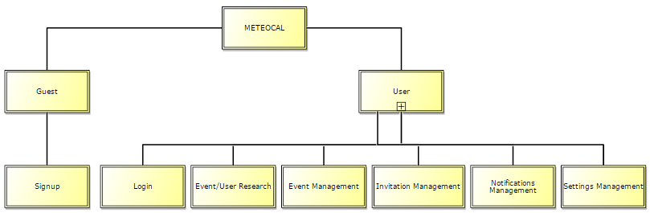
Architectural Description – Sub Systems
To better define the domains involved in our system, we decide to report here a top-down approach that will describe at a hight-level the subsystems our application is based on, and their relation with the actors interacting with the system.

Slide 21
Architectural Description – Sub Systems
Analysis of the previous scheme.
There are two main subsystems, the first is related to the Guest the second involves the User.
As it is easily observable, the guest can do only a simple operation of signing up. Thus, if he tries to make a different operation that requires the privileges of the User the system prevents this attempt.
On the other hand, the User has at his disposal all the functionalities offered by the system for managing events, user informations and the relationships with other users. In the same way, the system prevents attempts of signups made by Userwith checks on the username during the registration.

Slide 22
Architectural Description
We can than conclude that, this abstract separation in subsystems takes place in the real system in particular thanks to the usage of filters, security checks, and a strong splitting among functionalities.
As we will see in the next pages, our system has the following general modules:
View ( xhtml + css )
Web-Beans
Facade-Interface
FacadeImplementation-Beans
DAO

Slide 23
Persistent Data Management
Our application will make use of a relational database for persistent data management. So, starting from the specifications described in the previous section, we started designing it by following the process reported in the following slides.

Slide 24
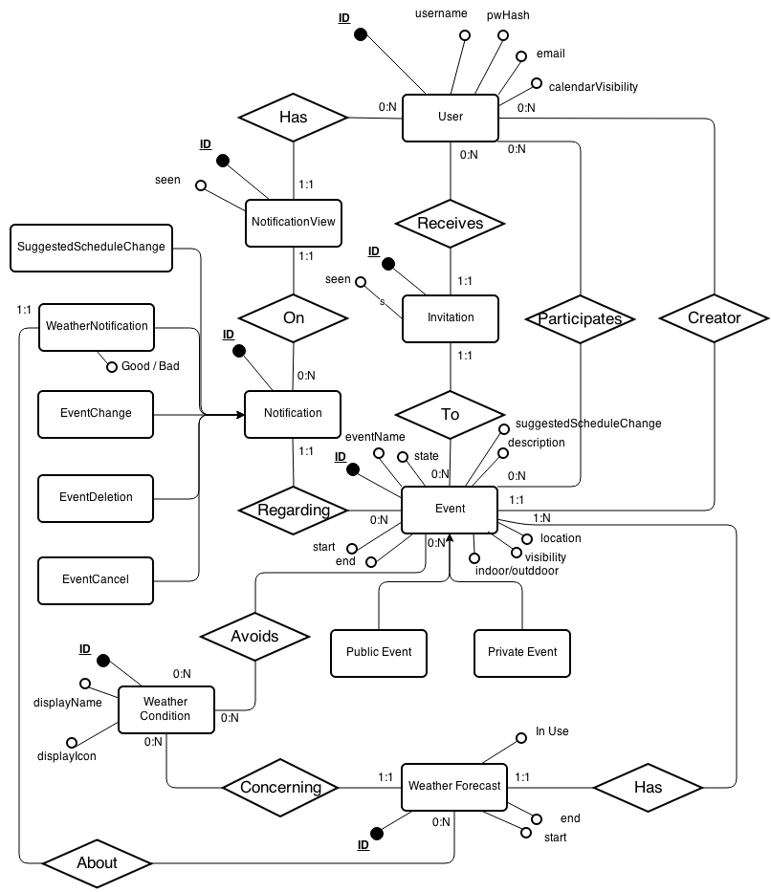
Persistent Data Management – Conceptual Design
Production of an ER diagram describing the conceptual design of the data structure:

Slide 25
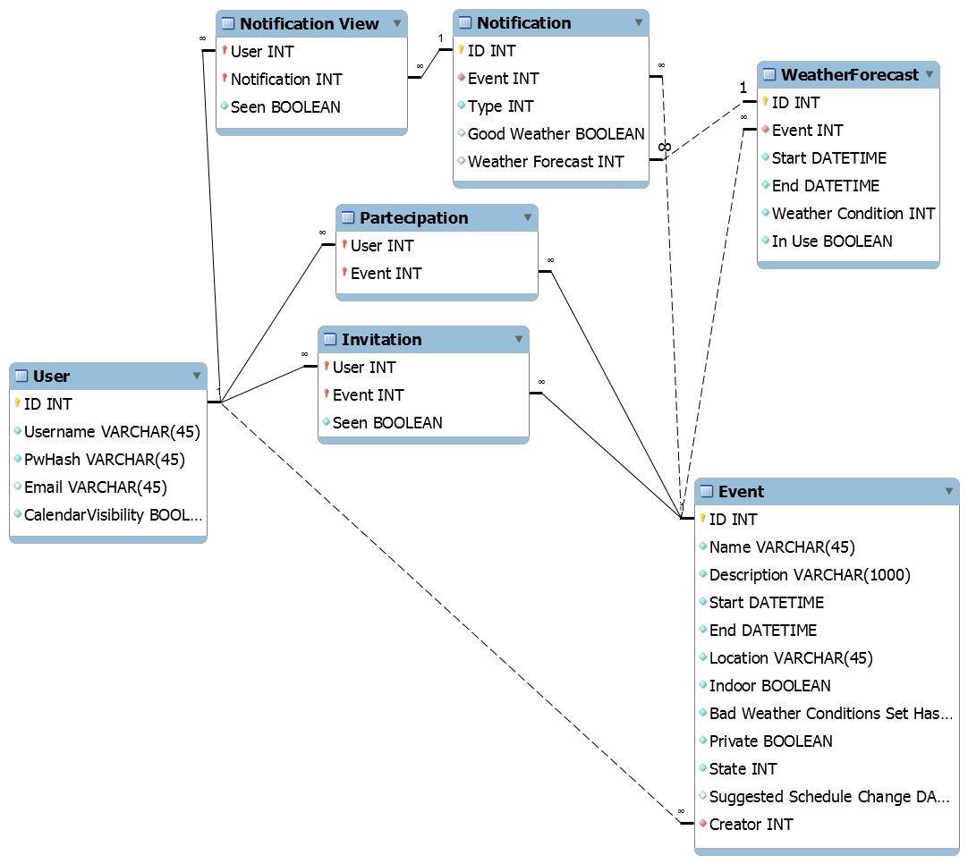
Persistent Data Management – Logical Design
Translation of the ER diagram into an actual relational database description by expressing the relationships between entities through the usage of foreign keys and and join tables.

Slide 26
Persistent Data Management – Logical Design
In our implementation, the database structure is actually created using JPA. This allowed us to benefit of all the tools the API offer, while also define some flexible behaviours for field conversions between Java objects and database entries.

Slide 27
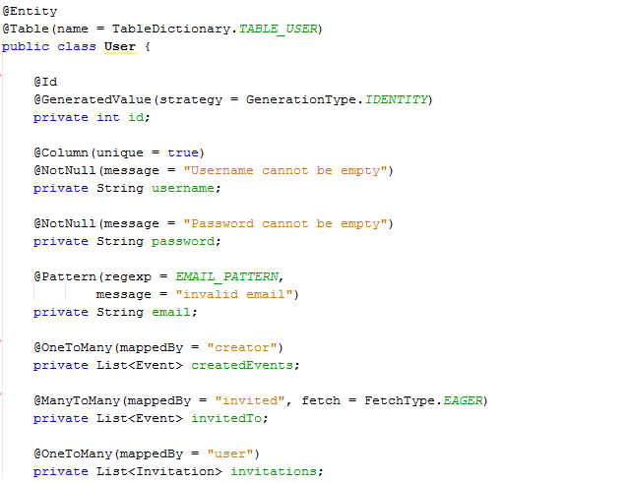
Persistent Data Management – Logical Design
An extract of the User table definition:

Slide 28
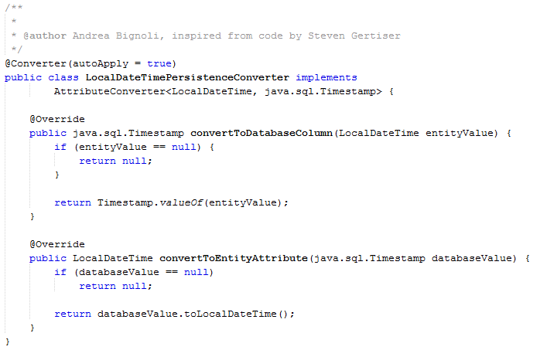
Persistent Data Management – Logical Design
JPA allows the creation of custom converters. For example, the following converter is used to efficiently convert the set of adverse conditions chosen for each event into an integer hash (representing the bitmask of the set).

Slide 29
User Experience – Introduction
In this section we are going to describe the user interface level of our application, we will focus the attention in the main aspects.
For each diagram we will show the relation that holds among:
The User Experience diagrams,
The real pages, with the some code particularly relevant.

Slide 30
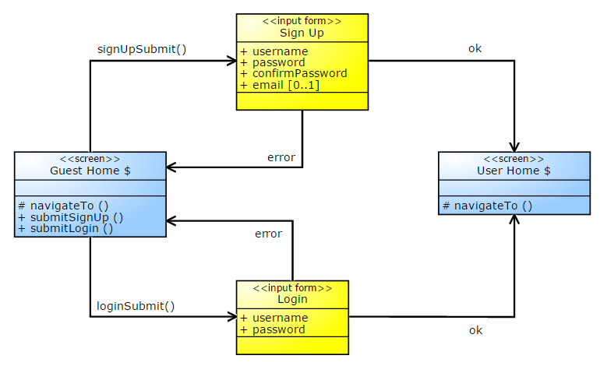
User Experience – Guest

Slide 31
User Experience
Correspondence between the diagram and pages.
The GuestHome takes place with the Index page: it contains the two forms, one for the registration and the other for the login. In case of error the user stays in the same page and an error message is shown.
The UserHome is realized with the HomeCalendar page: it contains the topbar that groups the main funtionalities as will be described in the next diagrams, and the connected user’s calendar.

Slide 32
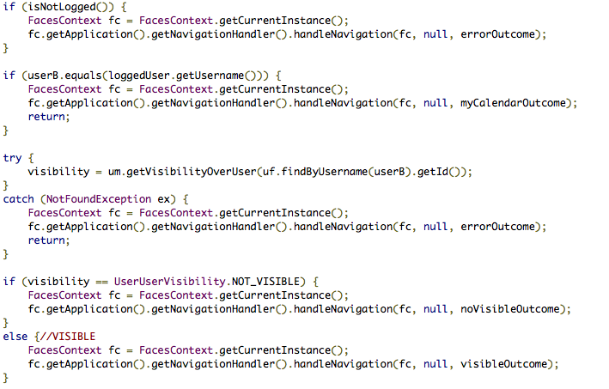
User Experience – Other User Calendar

Slide 33
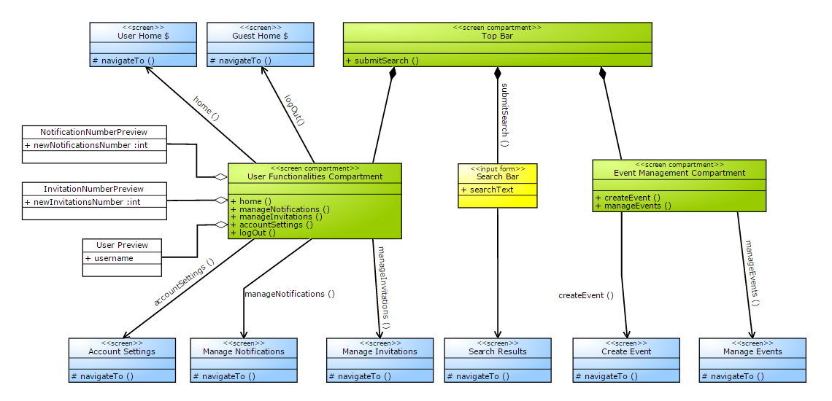
User Experience – Topbar
The Top Bar included in every user page of our platform:

Slide 34
User Experience
Correspondence between the diagram and the page.
This is the component that will be included in each page of the User Subsystem. As we have already said, it contains all the functionalities offered by the systems, it is like a bridge from the current page to the desired one.
It doesn’t contain only links to other pages, but also a search textarea that allows the research of user and events.
This is realized following the definition of component, in fact we have only one page that defines this module, all the other includes this one.

Slide 35
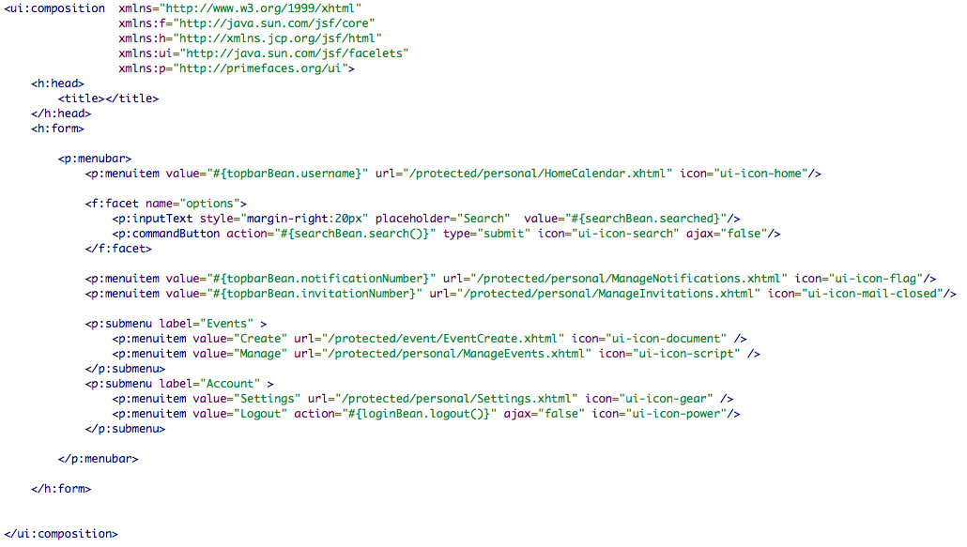
User Experience – Code

Slide 36
User Experience – Event Page
Now we will focus on one of the page with the main role in our system.
This page is not the page that contains all the details about the event, but is the page that has to evaluate the event relation over the connected user, and according to this results it dispatches the user to the right page.
We have made also complementary filters on the destination pages. So for example, if one tries to directly connect to the creator page even if he’s not the creator of the event, the systems prevents this operation.

Slide 37
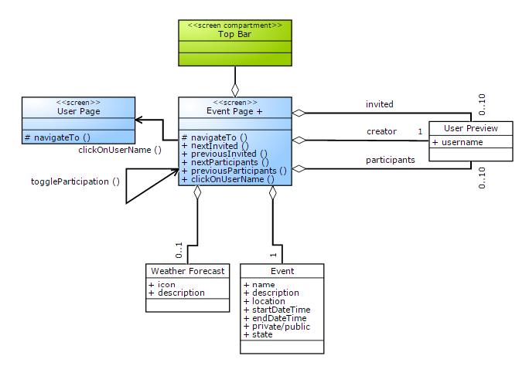
User Experience – User Visibility

Slide 38
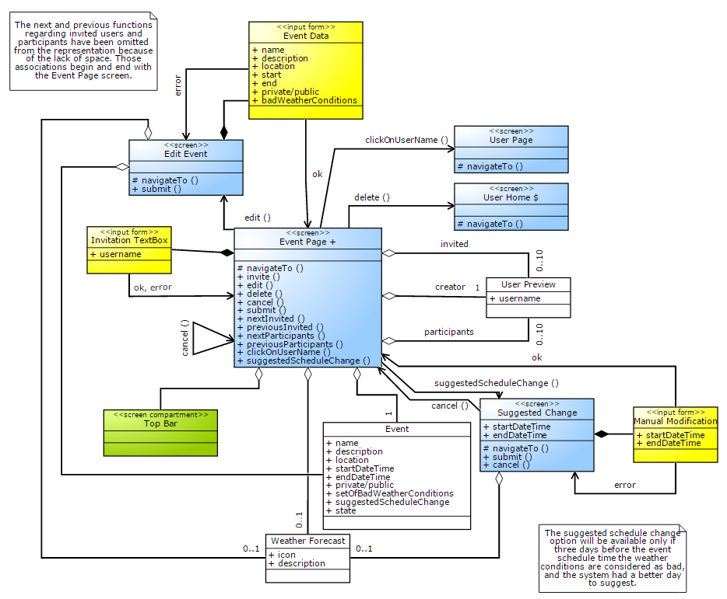
User Experience – Creator Visibility

Slide 39
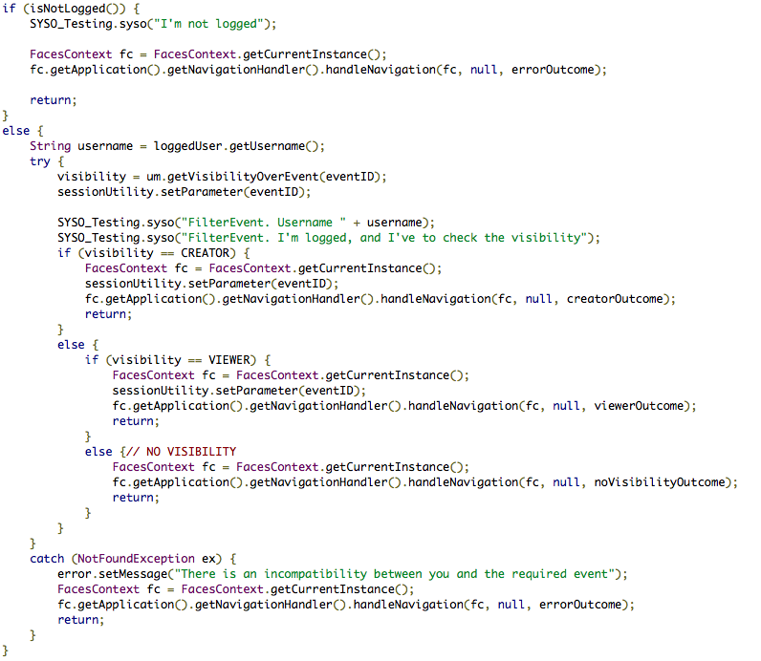
User Experience – Filter’s code

Slide 40
User Experience
In summary the events subsystem within the User domain is mapped with the following pages:
EventPage
EventPage As Creator
EventPage As Viewer
EventPage No Visibility
As was mentioned before, each page contains its filter except for the one that represents the case in which the user hasn’t visibility over an event, to allow perfectly safe resource management.

Slide 41
BCE – Introduction
Now we have decided to move back to the design representation, in particular here we will illustrate the BCE diagrams.
We do it for representing how we have respected the Model-View-Controller pattern with the schemes, knowing that:
Boundary: represents the view
Control: represents the controller
Entity: represents the model

Slide 42
BCE
Our purpose is not to replace the same detailed analysis made in the DD. We want to show more relations among models, that could not be mapped before the developing, and then there is not in the other documents.
Now we show the relation between the Controls in the BCE diagrams that was done before the developing and the beans.
We will do it not focusing once more on the already discussed modules, but moving a little along the not described components even if they may appear less important.

Slide 43
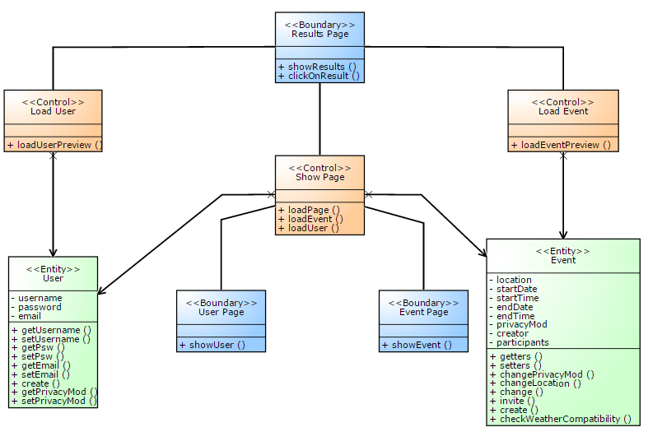
BCE – Search Bar

Slide 44
BCE – Search Bar
This module was touched on before just one time, but it is interesting. Its purpose consists of making a list of results splitted in events and users, according to the word that the connected user is looking for.
The association betwen the diagram and the real system is shown in the next slide.

Slide 45
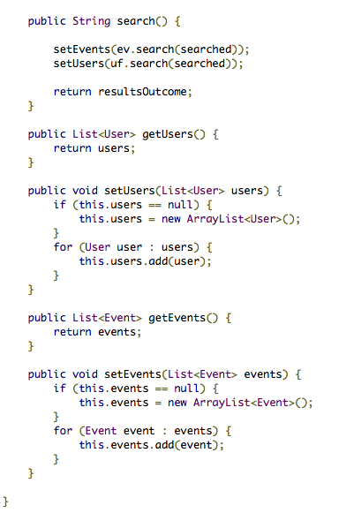
BCE – Search Bar Mapping
This is the source code of the SearchBean.
We point out the following functions:
search( ) : it loads the two sets of elements according to the searched word.
set/set user( )
get/set event( )
They translate the respectively functionalities:
loadPage
loadEvent
loadUser

Slide 46
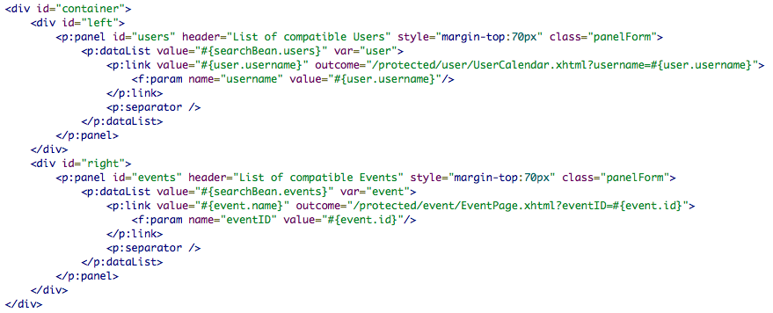
BCE – Search Bar Mapping
This is the xhtml page that actualize the ResultsPage, in fact it has also the same name.
From this page is possible to move to:
The Event Page;
The User Page.

Slide 47
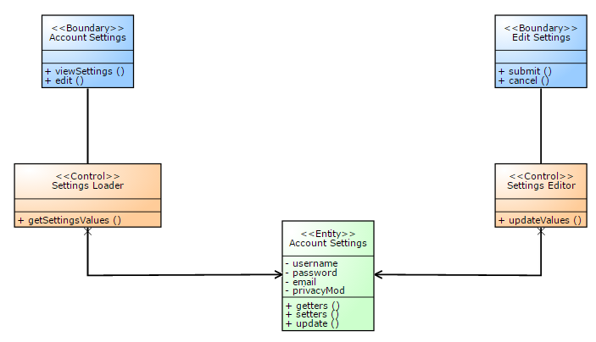
BCE – Settings

Slide 48
BCE – Settings
This module was never touched on before. Its purpose consists of loading the current setting values, and allows their editing.
As is represented in the scheme, in the real application we have:
Two pages: one for the settings loading and the other for the modification.
They are based on their respectively beans, which work on the same entity.
In the next pages we show this mapping.

Slide 49
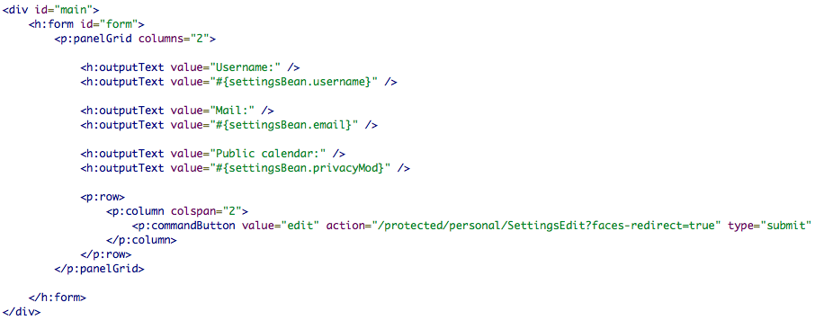
BCE – Settings Mapping
This is the account settings page, and as was designed before it contains the functionality to edit the current settings.
And it relates to the settingBean for the data loading, that is equivalent to the SettingLoader.

Slide 50
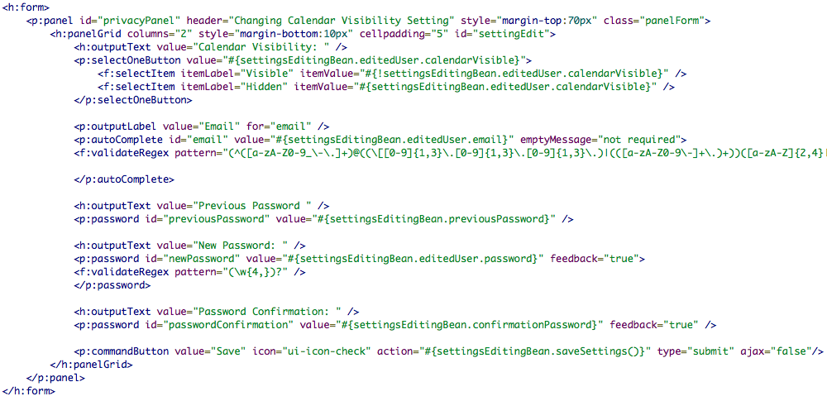
BCE – Settings Mapping
This is the page that allow the insertion of the new values, it has a form for submitting them as the Edit Settings Boundary.

Slide 51
Code Structure and Highlights

Slide 52
Implementation Assignment
For the implementation phase of the project we decided to split the work among us as described here:
Andrea Bignoli:
Business modules, database implementation, external weather forecast service interfaces, other back-end functionalities, some debugging and fixing activity in web tier
Leonardo Cella:
Web tier, web pages and managed beans, resources and information supply according to privacy level (all security operations are managed by business tier)

Slide 53
Code Organization
We mirrored the previous description with the creation of:
EJB Module:
Including all business operation related components
WEB Module:
Including all web tier components and client pages

Slide 54
Data Access Object Pattern
To make full use of the tools that JPA offer to developers, we decided to integrate this pattern in our system. In particular this allow us to introduce a further level of abstraction in the access to the data contained in the database.
To actually implement this we created a basic DAO including operations common to each entity we manage (e.g. Find by primary key). On top of this we created individual DAOs for each entity (thanks to class inheritance) to define functionalities related only to the entity that specific DAO refers to.

Slide 55
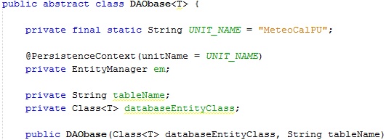
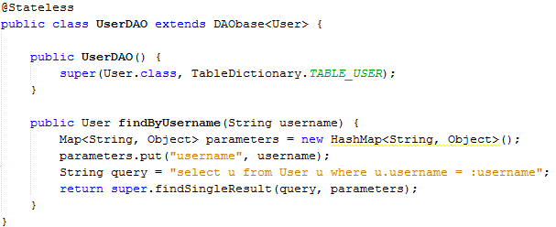
Data Access Object Pattern
First lines of the basic Data Access Object.
Specialization into User DAO by inheritance.

Slide 56
Interface Layers
To grant maximum maintainability and flexibility to our application, all the dependencies between the business tier and other components make use of interfaces.
For instance, every request coming from the Web Tier is actually directed to an interface defined for the facade that offers that service.
This weakens the component dependency constraints allowing greatly improved maintainability.

Slide 57
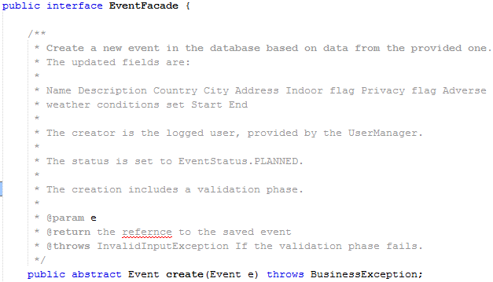
Interface Layers - Example
Consider for example the creation of an event, performed when the creator concludes the creation process on the web page. The EventCreationBean of the Web tier calls the create method of EventFacade, that manages event related operations:

Slide 58
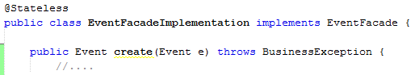
Interface Layers - Example
The execution is actually performed here:
This allows the maintainance of the create method. The only requirement is, in fact, to respect the JavaDoc description to respect the intended working.

Slide 59
Geographic Structure
During event creation the user can choose the location by selecting country and city from a list offered by the system.
The initial data can be found at this address:
http://www.unece.org/cefact/codesfortrade/codes_index.html
This data was converted in JSON format to be quickly loaded at startup by our application. The convertion was made using a Python script reported on the following slide.

Slide 60
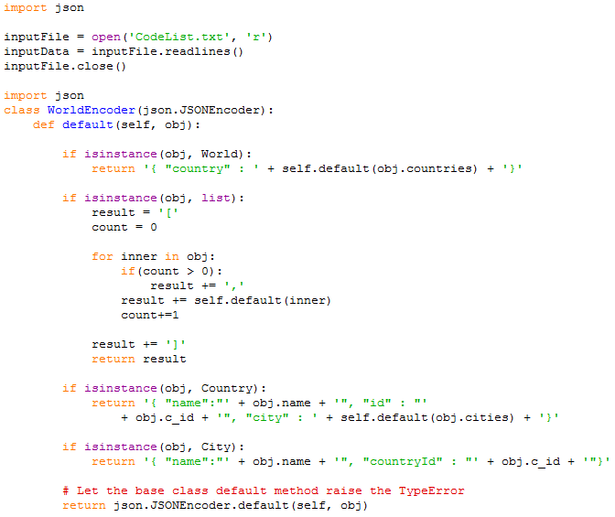
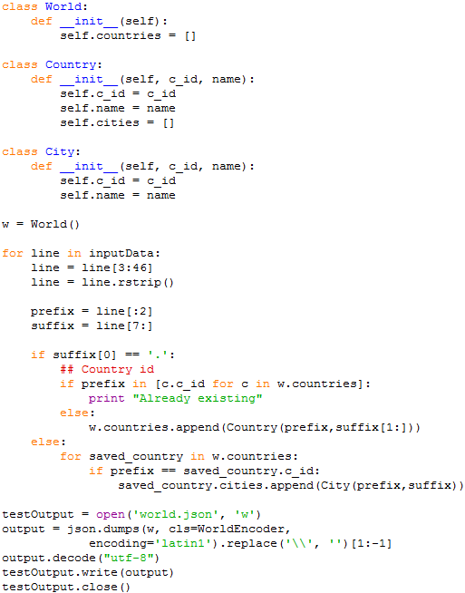
Geographic Structure

Slide 61
External Weather Service Interface
The application make use of OpenWeatherMap. The service offers forecasts:
For the next 5 days with a 3 hours precision
For the next 16 days with a daily precision
Even though the first would be enough to provide a service that perfectly respects the requirements, combining the information of the two forecasts clearly allows a better result.
We decided to follow this approach then, even if this increased the work in development.

Slide 62
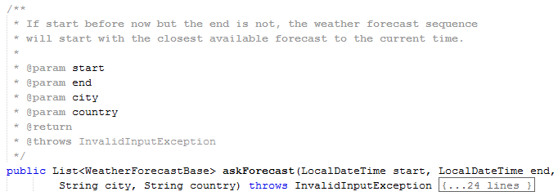
External Weather Service Interface
Our interface offers different functionalities to the rest of the application. The main ones are:
That returns a list of weather forecasts for the given location, covering the time interval delimited by start and end.

Slide 63
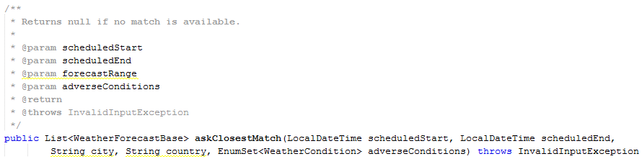
External Weather Service Interface
And:
That given location and current scheduling for an event, returns the closest time frame of the same duration with forecasts not in conflict with the specified weather conditions to avoid.
This is used to efficiently produce suggestions for schedule changes in case of bad weather conditions.

Slide 64
External Weather Service Interface
An important thing to note is that the algorithms implemented here make the least assumptions possible about the structure of the data the external service provides.
For example, if OpenWeatherMap changes their forecasts range and accuracy, our application will interpret that data in the right way nevertheless. Obviously this doesn’t hold if they change the data structure actually returned, since we can’t do nothing about that possibility.
Other than that our forecast interface allows much more than what MeteoCal offers. It would be possible to provide weather forecasts on demand to the user (not only for events), without modifying anything outside of the web tier.

Slide 65
Automated Testing
Due to the strict time constraints the automated testing doesn’t cover the whole application. We obviously can state though that, by the manual testing performed over the system, no anomaly has been observed. This process was also the base of our Test Cases document.
We focused mainly on Integration Testing using Arquillian. This type of tests covers for example, the whole operational cycle of our interfaces to the external service. This certify not only that it works, but also that it is coherent with the JavaDoc promises.

Slide 66
Demo

Slide 67
Demo
The following videos, will show some of the basic operations that can be performed in the system.
Naturally, due to the limited time available, the demo won’t cover all the functionalities that our platform offers. Any of the following can be tested by using the material provided in our repository by installing our system as explained in the Installation Manual.

Slide 68
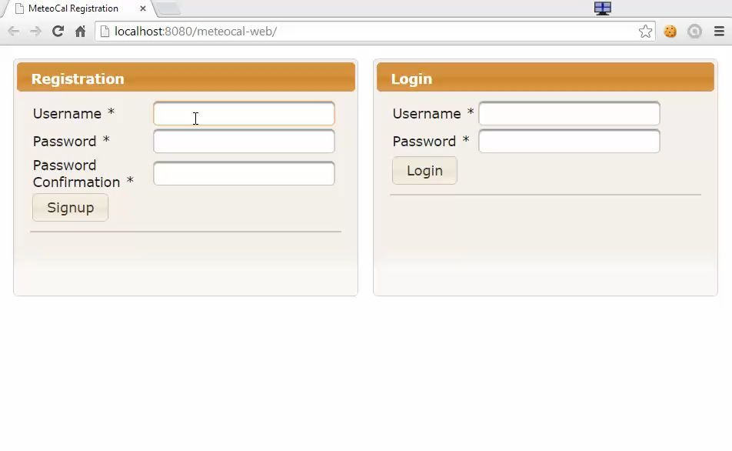
Demo - Registration

Slide 69
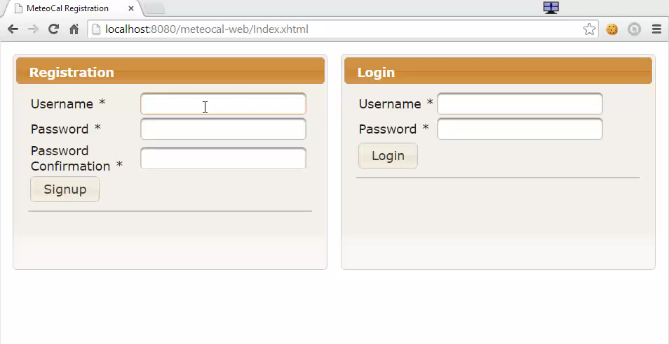
Demo – Registration with Error Handling

Slide 70
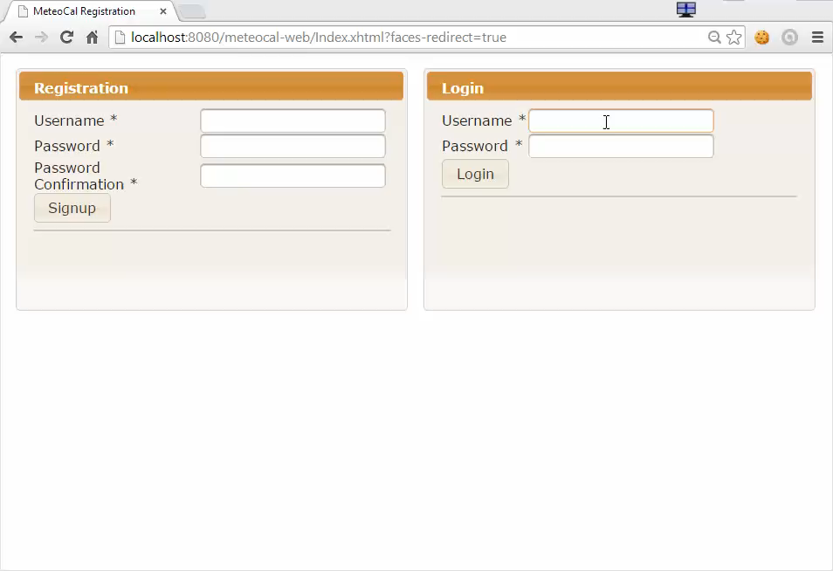
Demo - Login

Slide 71
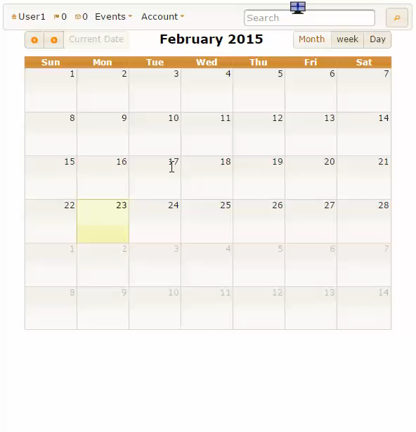
Demo – Create Event

Slide 72
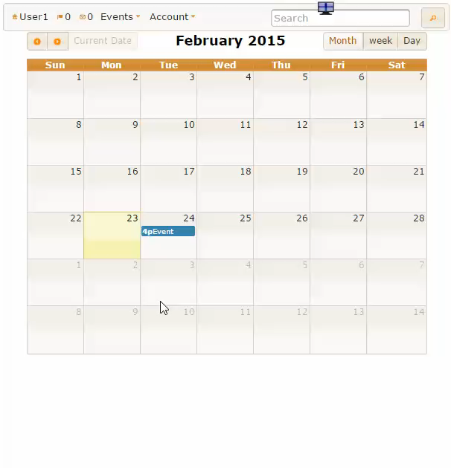
Demo – Invite More Users

Slide 73
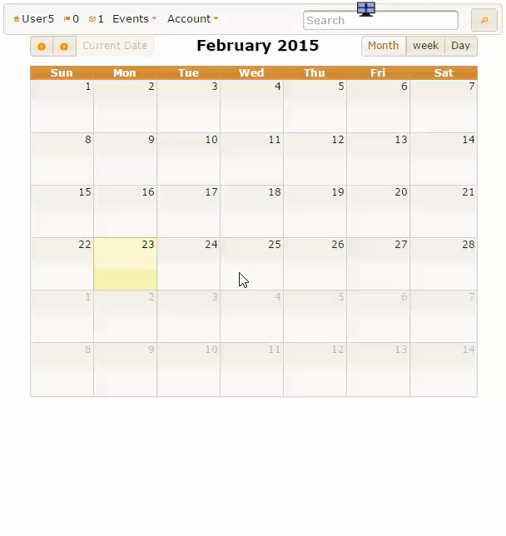
Demo – Decline an Invitation

Slide 74
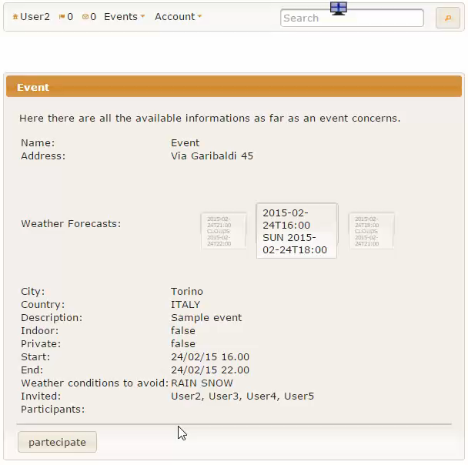
Demo – Join / Cancel Participation

Slide 75
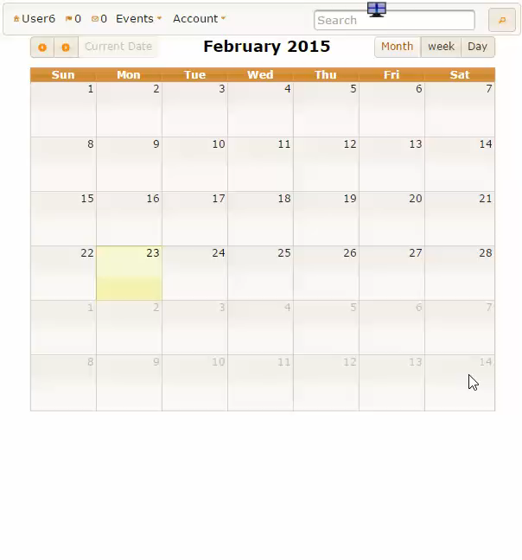
Demo – Search

Slide 76
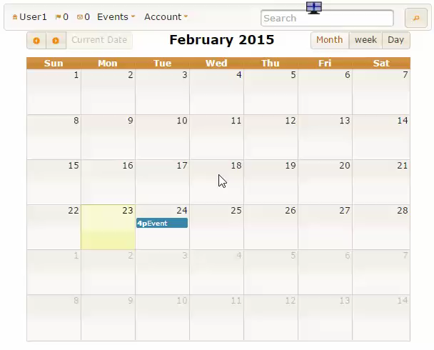
Demo – Edit Settings

Slide 77
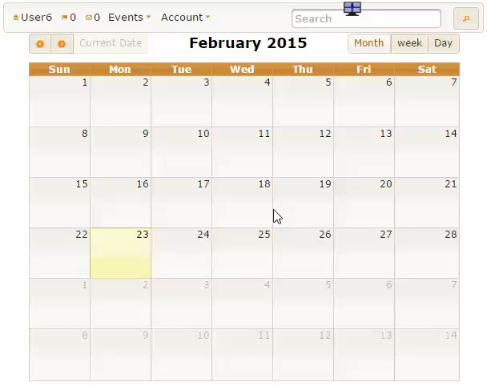
Demo – Public Calendar Visualization
One of the two events,
the second, is private, so no information is shown, other than the fact that User1 is busy in that time frame

Slide 78
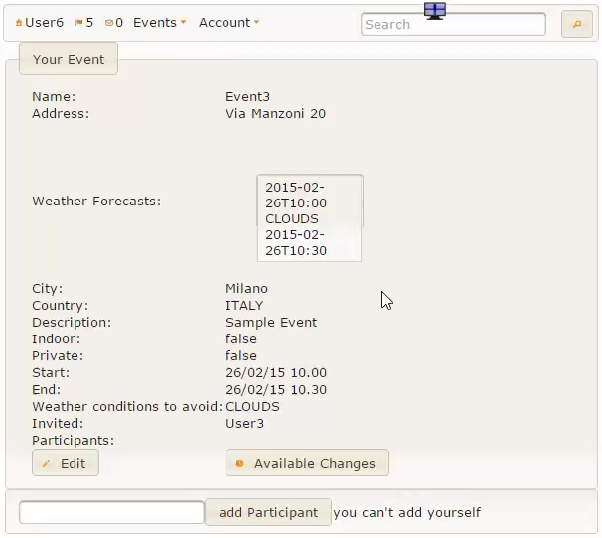
Demo – Suggested Re-Schedule

Slide 79
Project Report FP and COCOMO II

Slide 80
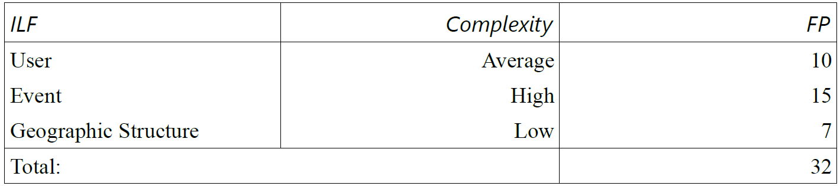
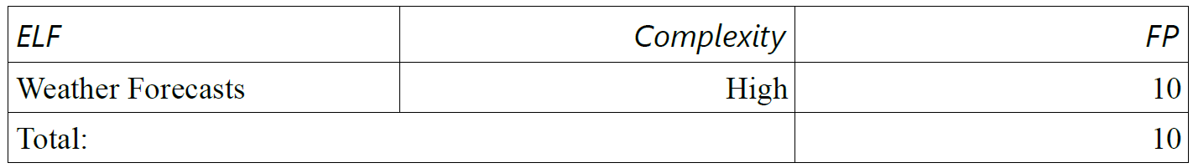
Project Report – FP
Internal Logic Files :
External Logic Files :

Slide 81
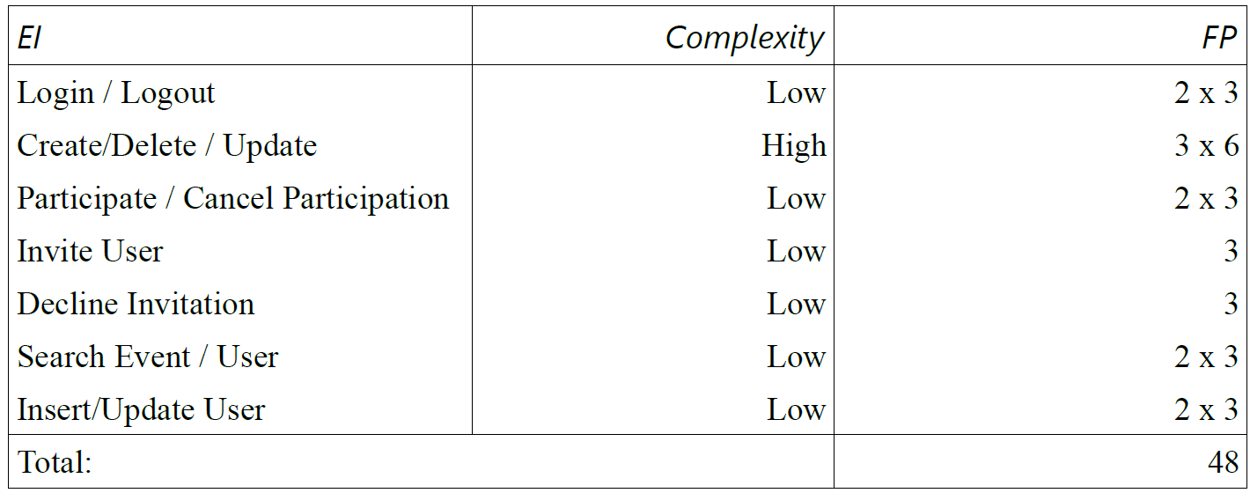
Project Report – FP
External Inputs :

Slide 82
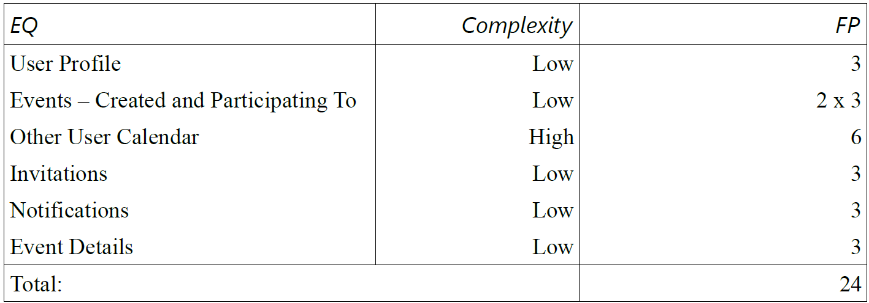
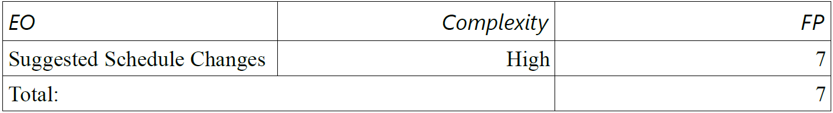
Project Report – FP
External Inquiries:
External Outputs:

Slide 83
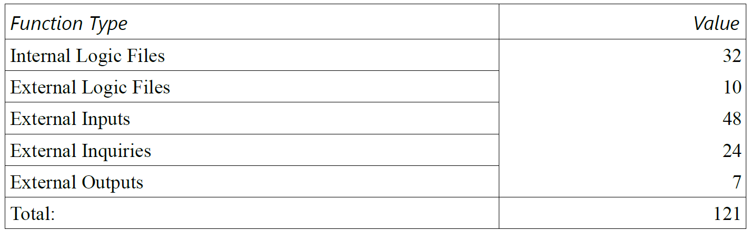
Project Report – FP
In summary:
With this estimation we get a LOC equal to:
121 * 46 = 5566
Our project is made of 7116 lines of code ( without considering empty lines, lines with only parenthesis or comments and css files).

Slide 84
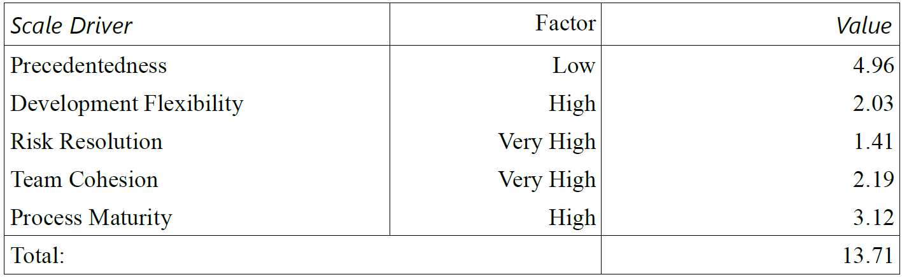
COCOMO II – Scale Drivers
These parameters were evaluated one per time, according to their
definition and not by taken the standard values.

Slide 85
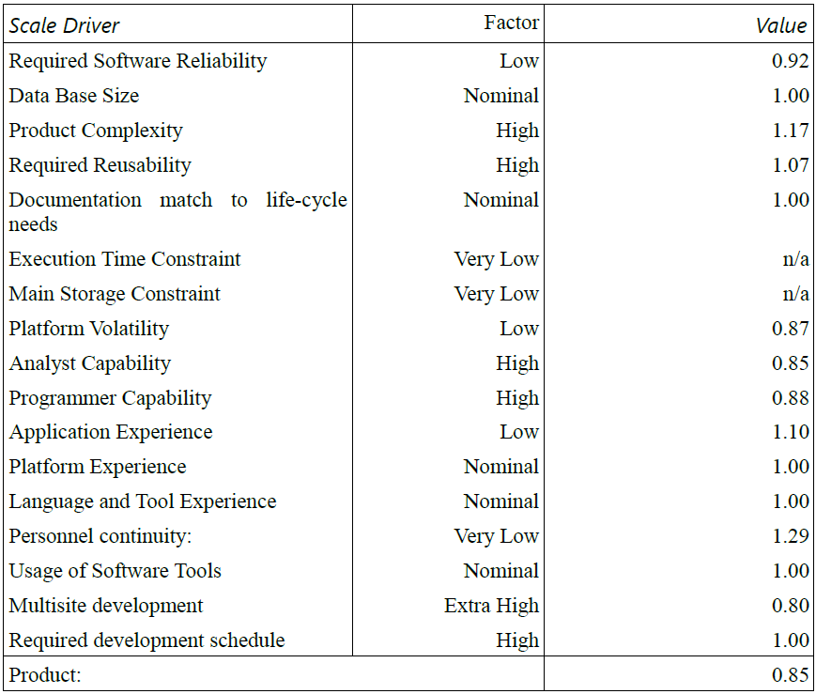
COCOMO II – Cost Drivers

Slide 86
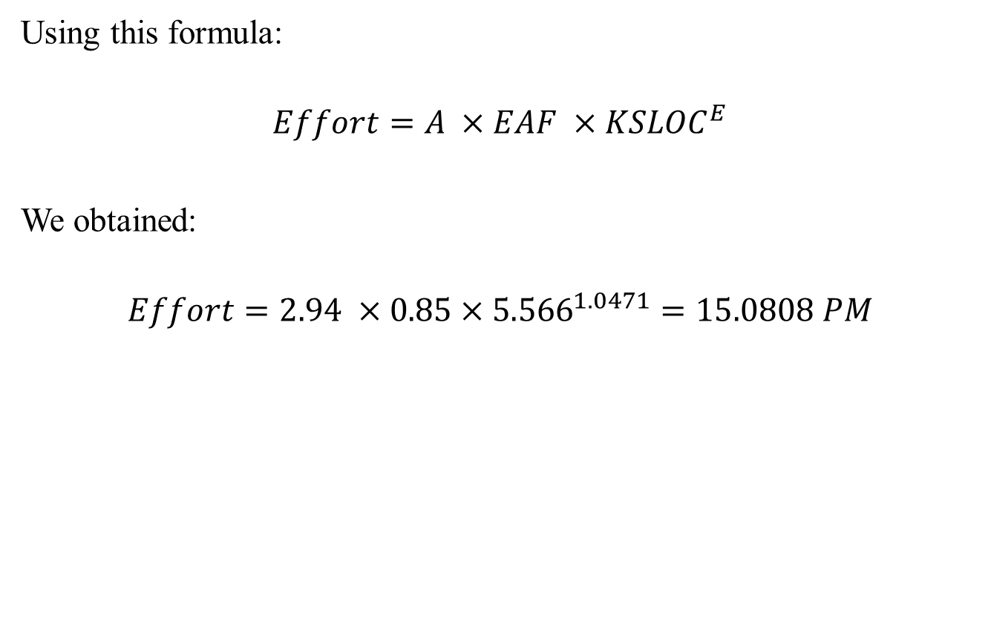
COCOMO II – Effort Calculation
Using this formula:
$$Effort=A ×EAF ×{KSLOC}^{E}$$
We obtained:
$$Effort=2.94 ×0.85×{5.566}^{1.0471}=15.0808 PM$$

Slide 87
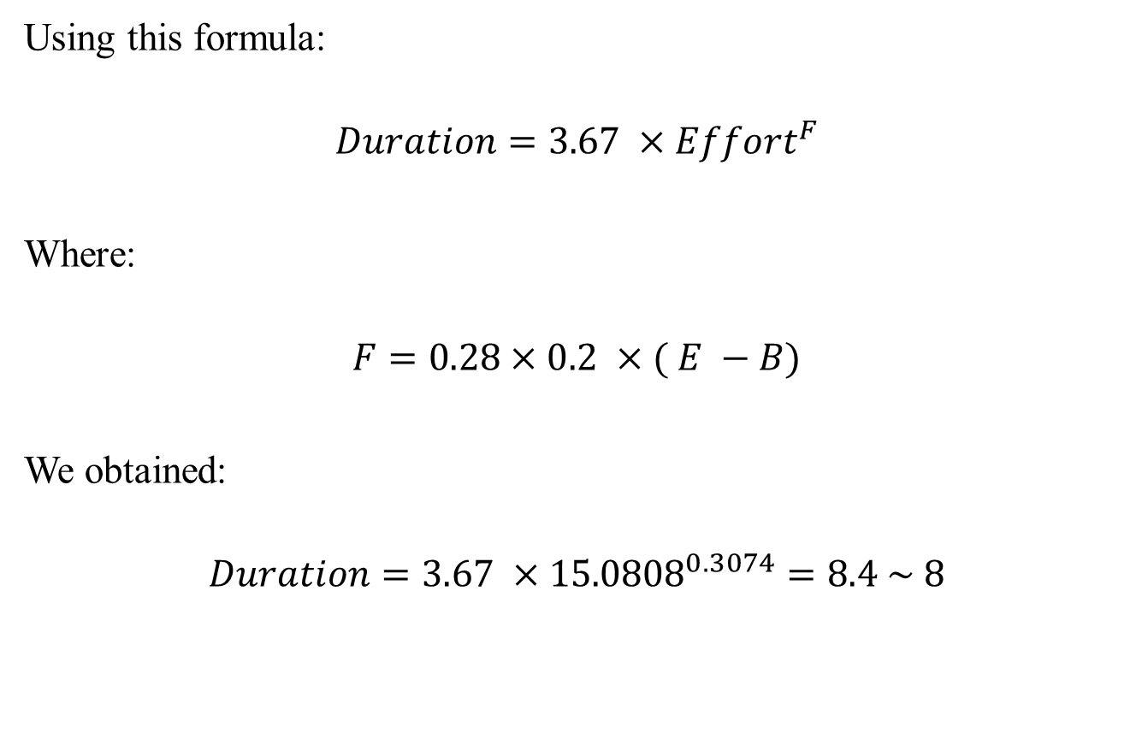
COCOMO II – Duration Calculation
Using this formula:
$$Duration=3.67 ×{Effort}^{F}$$
Where:
$$F=0.28×0.2 ×( E −B)$$
We obtained:
$$Duration=3.67 ×{15.0808}^{0.3074}=8.4 \sim 8$$

Slide 88

COCOMO II – Human Resources
$$P=\frac{Effort}{Duration}=1.79 \sim 2$$
This value is correct, but the estimated duration is far from the real value. In our Project Report document we performed a mathematical analysis showing that an error in our estimated values for FP, Cost Drivers and Scale Drivers can’t be the cause of this discrepancy, or, at least, not the only one.
The total amount of hours spent on the project, not including acceptance testing, project reporting and presentation is 455 hours. This value doesn’t explain the estimated duration either (considering the COCOMO II conversion factor of 152 hours per month).

Slide 89
COCOMO II – Wrong Estimation Analysis
The most likely explanation for this issue is probably the fact that we enforced the requirements of the project by always chosing the most flexible, complete and scalable option.
Moreover we also implemented different functionalities that weren’t included in the initial description, but that we considered really important for our service.
Another possible explanation could be the fact, that perhaps this project would have been more suited for a three people team, according to the COCOMO II analysis. That, at least, would have explained the obtained results.

Slide 90
Acceptance Testing

Slide 91
Acceptance Testing
In this section we will describe the acceptance testing performed over the implementation of MeteoCal by Salvatore Agnese and Gabriele Giganti. Their work can be found at:
https://code.google.com/p/meteocal1415agnesegiganti/
The details of this process are reported in the Acceptance Testing document that can be found in our repository.

Slide 92
Acceptance Testing
To perform this phase phase of the project as efficiently and accurately as possible, we devided our work in a Verification and Validation phase. The first steps are reported here:
Certify that functionalities promised in RASD satisfy the requirements described in the problem description
Check that the implementation of the system adheres to the guidelines of the RASD

Slide 93
Acceptance Testing
In this first part of the project we focused on the question:
“Does the software provide the functionalities required in the initial problem description?”
The answer, obtained by the analysis of RASD and the User Manual alongside with the actual implementation, was positive.

Slide 94
Acceptance Testing – System Test Cases
After the first phase we continued our analysis making sure that every functionality provided is actually working as expect, even in presence of erroneous input.
Initially we decided to follow the Test Cases document provided by the authors, classifying each test with an outcome, a list of issues and notes. The latter should be taken more as suggestions, to improve the software.

Slide 95
Acceptance Testing – System Test Cases
The possible outcomes of our analysis are:
• SUCCESS
If the main goals of the test have been accomplished and no highly relevant objection can be made to the management of any particular input condition.
• PARTIAL SUCCESS
If the main goals of the test have been accomplished but there is one or more highly relevant objection can be made to the management of a particular input condition stated or not stated in the test case documentation, but related to it.
• FAIL
If the main goals of the test have not been accomplished.
• UNKNOWN
If the occurrence of some particular conditions made the test unavailable

Slide 96
System Test Cases
The major part of the System Test Cases received a successful outcome. Even in those cases some improvements may be made following the test notes.
In the next slides we are going to show some examples of this process.

Slide 97

System Test Cases - Login

Slide 98

System Test Cases – Update Event
An other extract. As the previous one we will explain later the mentioned issue. In this case, updating an event causes the participants to lose their participation. Since this is probably intended, we classified the potential issue as a note.

Slide 99

Additional System Test Cases – Page Access
To complete the testing process, we decided to integrate the proposed test cases with an additional test.

Slide 100

Additional System Test Cases – Page Access

Slide 101
Additional Notes – Participation Management
Participation to the events are considered though as no more than a positive answer to an invitation. This causes some behaviors that may be considered rather unpleasant for the end user. An example of this is shown here:
The creator invites user X to event E.
X accepts the invitation and event E is added to X's calendar.
Creator of event E decides to remove the invitation sent to X. Consequence: the participation of X to E is completely removed, and E doesn't appear anymore on X calendar, while X doesn't receive any notice of this.
At the current state of the system, there's no way for a user to cancel his participation to an event.

Slide 102
Additional Notes – Page Navigation URLs
There is no way to get a link to the page of an event or of a user on the system, since the pages dedicated to showing these contents don't use the URLs to identify the resource requested by the system. While this doesn't represent an obstacle to the system in providing its services to the users there are also some negative consequences.
For example there's no way for a person to show an other a particular event since there is no way to link it, nor a search functionality.
Another important consequence is correlated to the security protection used in managing event privacy level and will be analyzed in the next section.

Slide 103
Additional Notes – Event Page Access
At the current state of the system the only way for a user to access the page of an event he's not invited to is clicking on that event on the calendar of a participant that has set his calendar as public. Even then, only invited users can actually participate to the event since there is no “Participate” button.
The only protection that a private event page has is actually the absence of a link to that page visible to user non invited to the event. This by itself, could be considered a rather unsafe approach to this resource management problem.

Slide 104
Additional Notes – Event Page Access
This approach in fact has a flaw in the current state of the system, even if its occurrence is rather hidden. The steps to observe this flaw are the following:
Public event E is created
Since the event is public, it will be visible on the calendar page of the creator or a participant to the event if the owner set his calendar as public. User U, not invited to the event, uses the search functionality to get on such page, where there is a link to E, since E is public and stops here
Creator of E modifies E writing secret information in the description of the event and setting the event as private
User U which still has available a link to E, since he got to a calendar containing it when E was public. User U can then use this link and access the page of E and read all sensible information contained in its description

Slide 105
Code Quality
The provided code has no documentation for the most part, since there is no JavaDoc and comments are almost totally absent.
On the bright side the structure of the code is very modular, and the operations contained in each module are usually not complex. So, regardless of the lack of documentation, the code should be maintainable with very little effort.

Slide 106
Conclusions
The set of operations performed in the system test cases fully covers the requirements extracted from the initial description.
As for the implementation, the majority of operations tested showed no highly relevant issues. There are anyway some that needs to be fixed since they can represent a danger for the execution of the system or problematic for the end user. The most important issue is probably the one regarding the fact that page access should be restricted to logged users, since it can lead to application failures.
To recap, the product answers fully the requests stated in the problem descriptions, but has some flaws that, for the most part, should be easily fixable. Moreover, the product offers functionalities that ease its usage. An example is the contact list, that allows suggestions for the users to invite to an event.

Slide 107
Acceptance Testing On Our Implementation

Slide 108
Acceptance Testing On Our Implementation
In this section we will answer some of the issues tracked in the Acceptance Testing document by Francesco Lattari and Alessandro Rimoldi, in which they analysed our production. Their repository can be found at:
https://code.google.com/p/meteocal-lattari-rimoldi/
Their evaluation of the System Test Cases defined by us confirms our results for the major part. In this section we will only go over the issues highlighted by them.

Slide 109
Acceptance Testing On Our Implementation - Login
About TC2 – Login:
"However if a user, once logged, manually inserts the address of the Index page, he can perform again the login, even if he’s already logged. This must be avoided."
This isn’t really an issue, and it doesn’t go against our specification. It is possible anyways to change this really easily by performing a check on page request, to see whether the user is already logged. If this is the case the user can be redirected to Home Calendar. As mentioned, this isn’t an issue, but can anyways be fixed in no more than 5 lines of code.

Slide 110
TITLE
About TC15 – Join/Decline Invitation:
"If the user accepts the invitation, the invitation still be visible on his invitations list and the “accept” and “reject” buttons are still available. So a user can accept the invitation continuously even if the system won’t do anything about that. The worst thing is that a user can first accept and then reject the invitation.“
This isn’t an issue. In fact, our specifications and our test cases clearly underline this behavior, coherent with the initial problem description. We assume that the testing group didn’t read this, and made wrong assumptions on the expected outcome. Anyway to obtain the result requested by the testing team, we would have to modify just one line of code.

Slide 111
TITLE
About TC18 – Visualize A Generic User Calendar:
“If the calendar privacy is set to “visible” and an event is set to private, the user can view that the request user is busy, but clicking on the event will redirect to the error page.”
This is a minor issue. The most expectable behavior on click for the end user is probably seeing nothing to happen, or obtain a dialog that explicitly tells that the event is private. Either way this could be done really easily by changing less than 10 lines of code.

